Slide 1
Introduction to Blockchain Programming
Dr. Adnan IMERI Technical Lead, INFRACHAIN and Luxembourg Blockchain Lab (LBL)
Disclaimer: This training intends explanation of technological advancements, and it does not intend any financial advice toward cryptocurrency or any digital asset!

Slide 2
Practical Information
Course Objective
To give broad into to BC prog. and guide the audience through first hands-on BC and Dapp
Course Organization
4 session (04/06; 11/06; 02/07; 09/07)
10:00 AM - 12:30 PM
Learning Outcomes
Explain the functional components of Blockchain and their interactions
Explain the fundamentals of Blockchain cryptography and consensus
Deploy and handle a basic Blockchain infrastructure
Use the Solidity language to program in the Ethereum environment
Write basic Ethereum smart contracts for tokens
Write basic Ethereum smart contracts for decentralised applications
Attendance: Is checked and signed and each session
Resources
Git: https://github.com/adnanimeri/BCProgramming
Literature suggested during the course

Slide 3
Send me an email to get access to c
Get Access to Course Content
Send me an email with your git account
adnan.imeri@infrachain.com

Slide 4
Course Timeline

Slide 5
Table of Content
Smart Contract
Recall ERC 20
ERC 721
Decentralized application (Dapp)
Web 3: Interaction with Smart Contract
Environment setup
Web3 Methods
Exercises

Slide 6





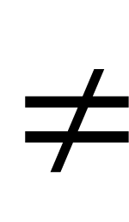
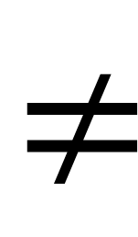
Token ERC 20 / ERC 721
Fungible – are tokens that are tradable units
Non-Fungible Tokens – are the ones that are not tradable, and represent something unique
NFTs can be used to represent digital art
=
=
$$≠$$
$$≠$$

Slide 7
ERC721
Standard Smart Contract for Non-Fungible Tokens
function mint(address to, uint tokenId) external {
require(to != address(0), "mint to zero address");
require(_owners[tokenId] == address(0), "token already minted");
_balances[to] += 1;
_owners[tokenId] = to;
emit Transfer(address(0), to, tokenId);
}
/Session2/dev/ERC721

Slide 8
Dev Environment Preparation
Installing a full Ethereum node using Geth
Requires full node synchronization
High computing resources
Ganache: “local” blockchain node
Node.js
Web3: JSON-RPC (remote procedure call protocol)

Slide 9
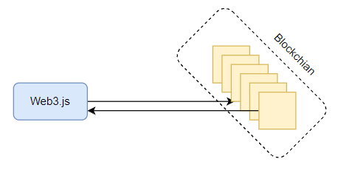
Developing with Ethereum (DAPP)
Decentralized application (Dapp) is a type of software that exists and runs on a blockchain (peer-to-peer) mode of communication. The “backend” runs in many “nodes” instead of a single “node”.
Any “Dapp” need a way to communicate with blockchain!!
Composition of Dapp → Two sides of the equation:
I: Development of Smart Contracts
- deployed and running in blockchain
II: Client (“website”) application
- interact (“talk”) to blockchain
DAPP_Equation = I + II
Notes:
Development of Smart Contracts, which will be deployed at the blockchain (ethereum)
Client application*, think of it as an request to server or API when develop a web-application
*This is where Web3.js comes to the play.

Slide 10
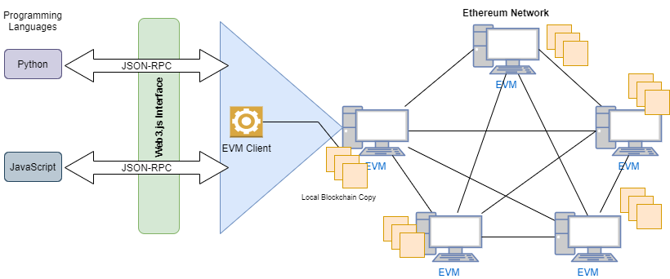
How an Web Site (client) will talk to blockchain ?
Prog.Language-->JSON-RPC (Enabled by Web3.js)--> Ethereum Client (local copy of blockchain)

Slide 11
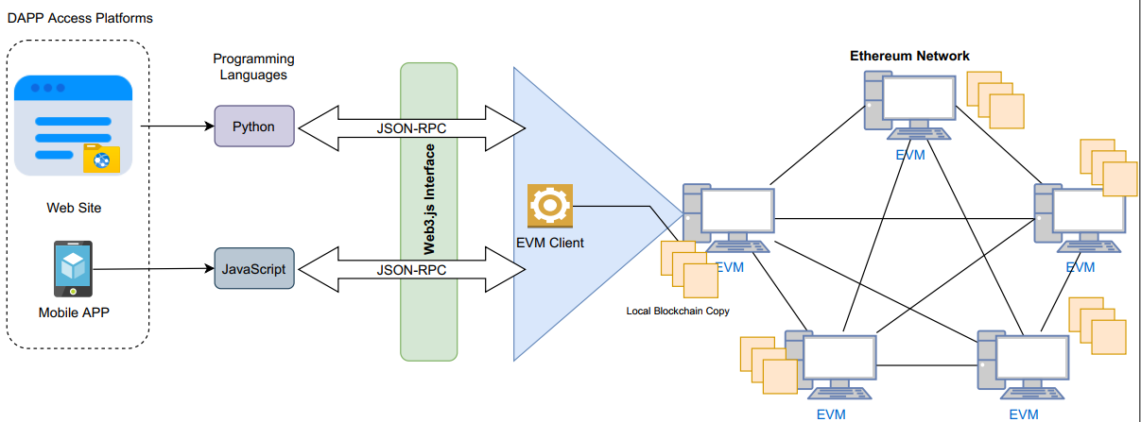
How a Web Site (client) will talk to blockchain?
Dapp Structure

Slide 12
Web3.js
Web3.js is a collection of libraries which enables interaction with blockchain
Main javascript library to interact with the blockchain.
Composed of methods that enables operations in blockchain
Installation:
Requires Node.js
npm install web3
and local node
// In Node.js use:
const Web3 = require('web3’); const web3 = new Web3(Web3.givenProvider || "ws://localhost:8545");
web3 - is an object!!
Git source: https://github.com/ChainSafe/web3.js

Slide 13

Lets programm: Setting up Web3
Now, lets connect it with the remote or local or blockchain environment
Ganache local “virtual” local environment
→ Download and Install Ganache
Enter to node environment
Write code (figure on right) /dev/web3ganache.js
Remote Environment:
We can use API provided from infura.io
var Web3 = require('web3’)
var url = 'https://mainnet.infura.io/v3/d79e79983f574612b85eefebcdd35e6e’
var web3 = new Web3(url)
//print all web3 methods. ...
console.log(web3)
/dev/web3infura.js
Local Environment:
> node
> const web3 = new Web3(Web3.givenProvider || "ws://localhost:8545");
Notes:
We can use API provided from infura.io
To perform testing and programming you can use ropsten network.
>node
>var url = ‘https://mainnet.infura.io/v3/bf4f50dcc14d4ecba3c175d6d1723ec1’
>var web3 = new Web3(url)
>check it by typing web3 in CLI

Slide 14
Web3 Libraries
var Web3 = require('web3');
> web3.utils
> web3.version
> web3.givenProvider
> web3.providers
> web3.modules -- > list of all sub-modules used for interaction with web3 components

Slide 15
Web3 Libraries
Web3.Module. →

Slide 16
Accounts and Balances
Two type of accounts in Ethereum
User Account and Smart Contract accounts.
Use Infura to set Rinkeby RPC connection.
To create an account use the following code:
web3.eth.accounts.create();
Attention exposing of private key. You should never expose it!!!
Check balance of an account (Rinkeby network)
>var myAccount = '0x96B5834632ea9546bA0C990574Ba8e348603F93c'//the account which you have created already or any other depend on blockchain environment.
> web3.eth.getBalance(myAccount, (err, bal) => {balance = bal})
> balance

Slide 17
Accounts and Balances
The “55735052590917400690412” presents the balance of account in tiny values (Wei). An analogy with this is like euro cents.
We can convert this into more meaningful values
>web3.utils.fromWei(balance, 'ether') //we wanted to have ether
'55735.052590917400690412'
Check it on in Rinkeby: https://ropsten.etherscan.io/address/0x96b5834632ea9546ba0c990574ba8e348603f93c
You can convert it in other units, e.g., gwei, Kwai,...
web3.utils.fromWei(balance, 'ether’)
Ether units are shown in this link.

Slide 18
Web3.js: Interaction with Smart Contract
With Web3.js we create an abstraction to interact with Smart Contract deployed in EVM. Smart Contract are written in solidity.
Solidity, is a programming language that enables the development of smart contracts.
Deployment: Compiled (solidity compiler) and deploy binary code in blockchain (EVM).
To interact with Smart Contract, we must know its address (account), and its interface (know what its function will do, …) on the blockchain.
Notes:
Here the question is how to make Web3.js to talk to a smart contract?

Slide 19
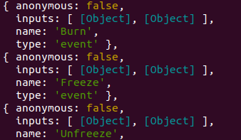
Web3.js: Interaction with Smart Contract
To know the interface of Smart Contract we need to get ABI (Application Binary Interface)!!
Basically ABI is a JSON file which shows what an SC can do and its functions. For example, this is the ABI of an SC called X (provide git)...
We take an ABI from an SC for example an ERC-20 token, e.g.,
https://etherscan.io/address/0xB8c77482e45F1F44dE1745F52C74426C631bDD52#code
> var ABI = paste the taken ABI of SC
> ABI // and you will see structured JSON-like code
Notes:
Here the question is how to make Web3.js to talk to a smart contract?

Slide 20
Web3.js: Interaction with Smart Contract
Now, we need the address of SC. We copy the SC address from etherscan.
var address = '0xB8c77482e45F1F44dE1745F52C74426C631bDD52’
Now we need to get connected to SC with Web3!
> var contract = new web3.eth.Contract(ABI, address)
> contract //we check if we have the instance of the contract and all information related.
> contract.methods //we see all SC function as defined in ABI
> contract.methods.name() // return the function with that name e.g., name()
contract.methods.name().call() //calls function e.g., name()
--> Of course this will return a promise (since we are in an asynchronous environment)
Notes:
contract.methods.totalSupply().call()
Promise {
<pending>,
domain:
Domain {
domain: null,
_events:
[Object: null prototype] {
removeListener: [Function: updateExceptionCapture],
newListener: [Function: updateExceptionCapture],
error: [Function: debugDomainError] },
_eventsCount: 3,
_maxListeners: undefined,
members: [],
[Symbol(kWeak)]: WeakReference {} } }

Slide 21
References
[1] Imeri, Adnan. Using the Blockchain Technology for Trust Improvement of Processes in Logistics and Transportation. Diss. University of Luxembourg,​ Esch-sur-Alzette,​​ Luxembourg, 2021.
[2] ERC20: https://ethereum.org/en/developers/docs/standards/tokens/erc-20/
[3] Proof of Work: https://www.ledger.com/academy/blockchain/what-is-proof-of-work/
[4] https://www.sohamkamani.com/nodejs/rsa-encryption/

